Slide 1
Design & Implementation of real time tempeature monitoring & hand sanitizer dispensing system for quality health care using Ardunio
G Madhumita & K Saravana Kumar
B.E IInd year Computer Science and Engineering
Anna University Regional Campus Madurai

Slide 2

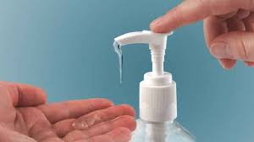
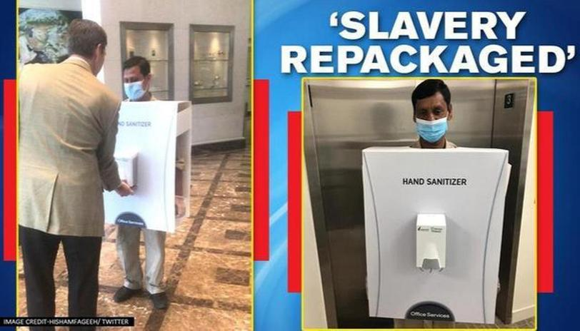
In this current scenario of global outbreak, it is advised to maintain healthy hand wash and sanitation habits. But the main problem is the way we do it, that is by physical touch to the bottle.
It doesn’t serve our purpose
In some places an assitance is made to dispense sanitizer for hours but it isn’t the possible situation everywhere.

Slide 3
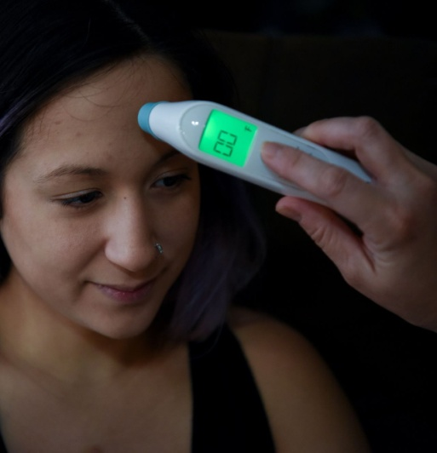

The continuous body temperature monitoring is the one of the way to detect a corona patient.
The ability of normal thermometer can measure the body temperature regularly but it also may spread the virus over the physical touch.
Currently, Infrared thermometers have been in use which is also known as temperature gun.But it is costly .

Slide 4
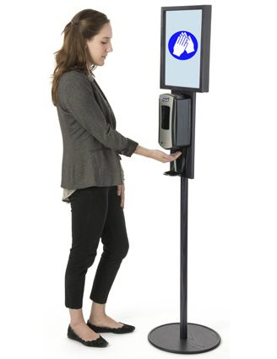
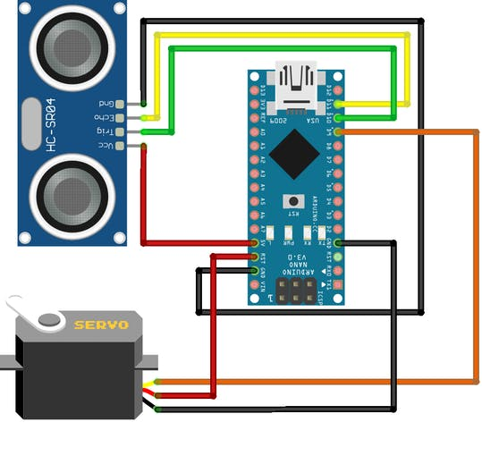
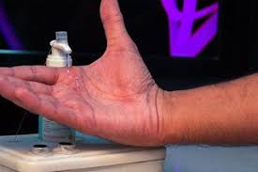
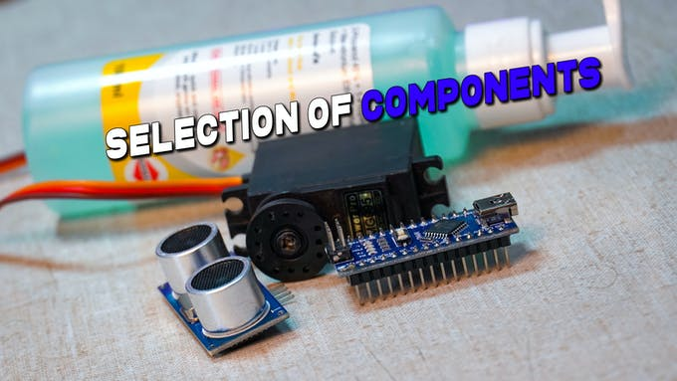

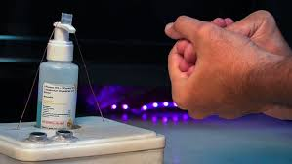
Non Contact Thermometer and Hand Sanitizer Dispenser
which is built using Arduino Nano R3 and sensors like MLX90614
for sensing non contact temperature and ultrasonic sensor to sense
the hand for automatic disposal of sanitizer regularly.
contactlessHand Sanitizer Dispenser

Slide 5
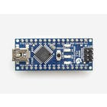
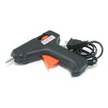
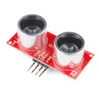
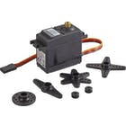
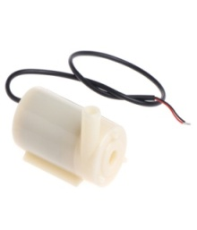
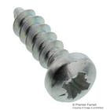
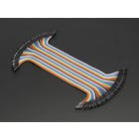
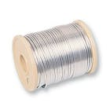
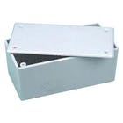
Components needed:
Electronics:
Arduino Nano
Ultrasonic Sensor
(HC-SR04)
Servo motor
Jumper Wires
Tools:
Hot Glue Gun
Computer or Laptop.
Misc:
Alcohol Based Hand Rub or Sanitizer
Self Threading Screw
0.8 mm copper wire
container.

Slide 6
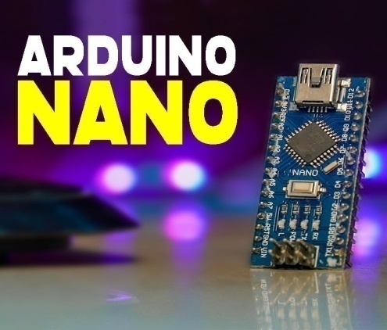
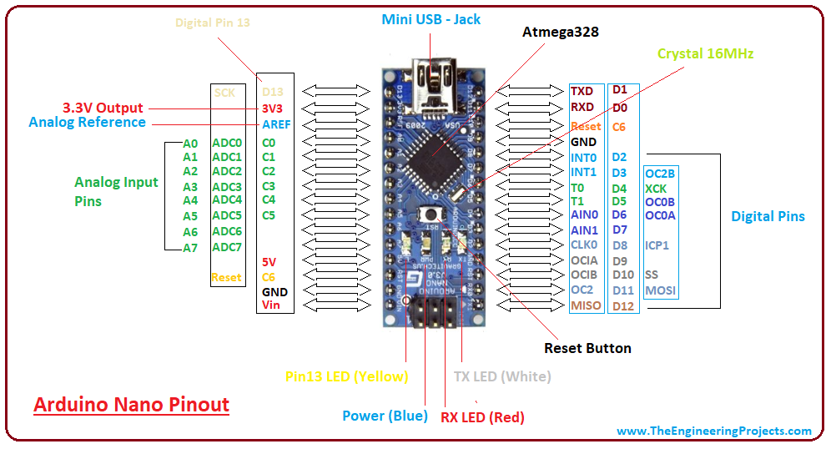
The Nano Arduino is a small, complete, and breadboard-friendly board based on the ATmega328 (Nano R3).
It lacks only a DC power jack and works with a Mini-B USB cable instead of a standard one.
Microcontroller | ATmega328P – 8 bit AVR family microcontroller
Operating Voltage | 5V
Recommended Input Voltage for Vin pin | 7-12V
Analog Input Pins | 6 (A0 – A5)
Digital I/O Pins | 14 (Out of which 6 provide PWM output)
DC Current on I/O Pins | 40 mA
DC Current on 3.3V Pin | 50 mA
Flash Memory | 32 KB (2 KB is used for Bootloader)
SRAM | 2 KB
EEPROM | 1 KB
Frequency (Clock Speed) | 16 MHz
Communication | IIC, SPI, USART

Slide 7
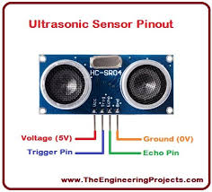
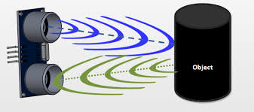
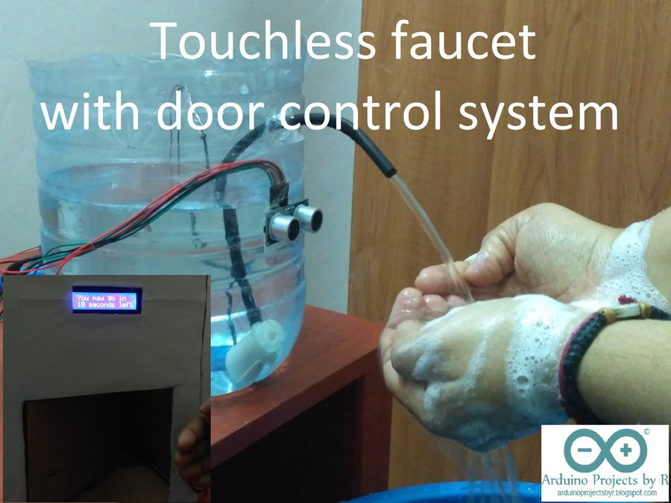
HC-SR04 Ultrasonic (US) sensor is a 4 pin module, whose pin names are Vcc, Trigger, Echo and Ground respectively.
Range:2-400cm
The sensor works with formula
Distance = Speed × Time
We will avoid using micro pumps, since they are to be inserted into the container, which again creates vulnerable containment spot. So using an external mechanism with help of servo would be a wise choice

Slide 8
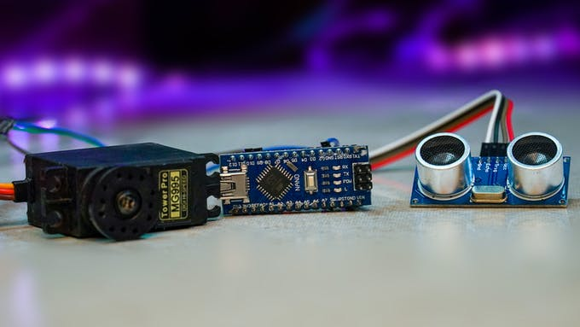
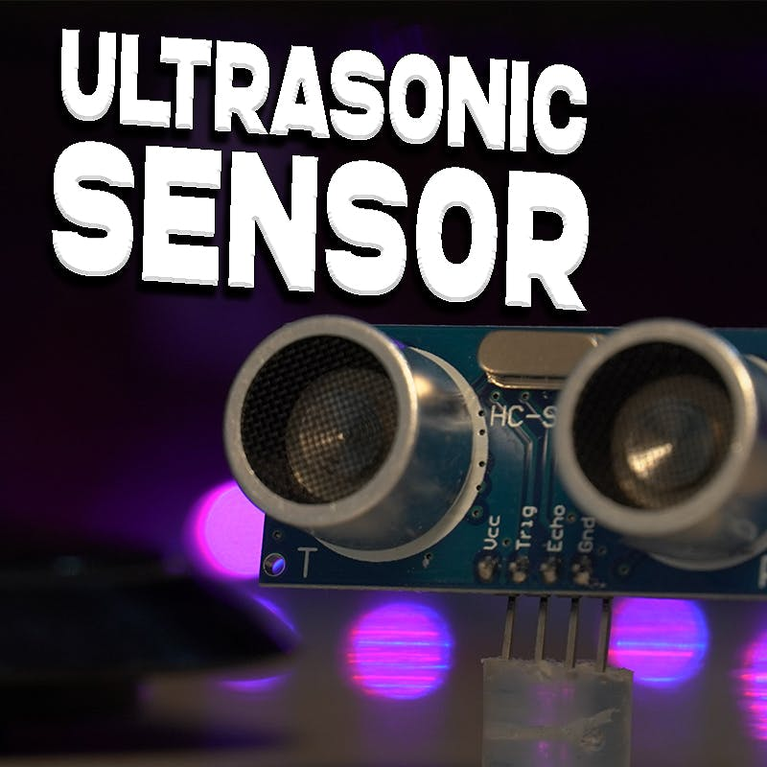
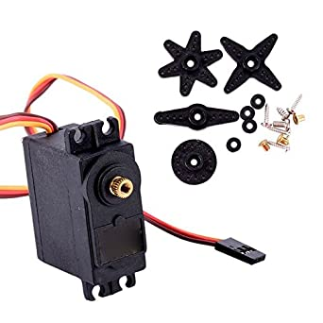
Connections for this build is very simple !
Sensor to Arduino: Servo to Arduino:
Trigger to D10 Signal to D9
Echo to D11
Vcc to Vcc gnd to gnd
Gnd to Gnd
Vcc to Vin

Slide 9
Upload the code
We use the servo library, and define basic setups and variables, the main code is such that it calculates the distance in centimeters and if the distance is less than 10 cm the servo motor performs a sweep motion to release the liquid.
Whenever we place our hand near sensor and distance for ultrasonic drops below 10 cm, servo motor gets engage and the alcohol hand rub will dispense automatically.

Slide 10
We will need a mechanism which will create a force to push the nozzle down and dispense the liquid
we will use pulley mechanism to fix one end and convert the rotational force to push, we can do that using Copper Wire to create a downwards vector force for transmission
Pass the Copper Wire through Servo motor using the holes on Attachment Arm, pass at least through 2 holes to ensure proper tension is achieved using circular attachment arm would be better choice, since straight one can get caught inside enclosure.
Add Piece of Hot Glue Stick With Hole in Middle to increase the surface area
Attach the second end of wire to another rigid surface (opposite face of servo motor), using a Self Threading Screw now when the motor sweeps the sanitizer ‘ll dispense automatically.
We can just put this setup inside a box .We can use Sharp Blade or Drill to plot the holes and fix them up using glue stick.

Slide 11



MAIN COMPENTENTS of ir thermometer
MLX90614
ARDUNIO NANO R3
ANDROID DEVICES
OTG CABLE

Slide 12
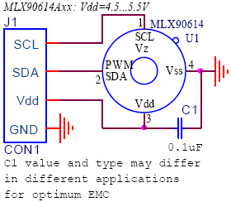
FUNCTIONAL DIAGRAM
ARDUINO NANO MLX90614
A4 SDA
A5 SDL
3.3V Vcc
GND GND

Slide 13

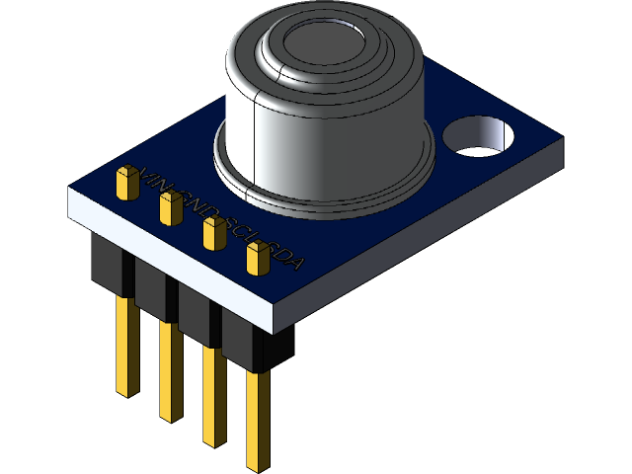
WHAT IS MLX90614 ?
Contact less temperature sensor
Obey Stefan-botzman Law
Embedded with two devices
Devices acts as a sensing and processing units
MLX81101
IR THERMOPLIE DETECTOR
MLX90302
SINGLE CONDITIONNG ASSP

Slide 14

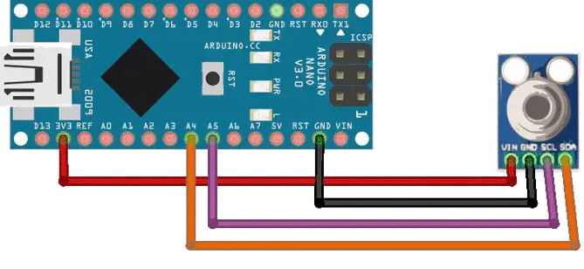
INSTALATION PROCESS
Step 1: First we need create
sketch using ardunio
IDE
Step 2: Code setup part
Step 3: Upload the code to
ardunio nano
Step 4: Set the baurd rate

Slide 15

WORKING…….
The sensing unit in the sensor measures how much IR energy is emitted by a targeted object and the computational unit converts into temperature value using a 17-bit in built ADC and outputs the data through I2C protocol.
The sensor measures both the object temperature and ambient temperature value. The object temperature measurements can range from -70 to 382.2 °C (-94 to 719.96 °F), while the ambient temperature reading ranges from -40 to 125 °C.
Both the ambient temperature and object temperatures have a resolution of 0.02 °C.

Slide 16
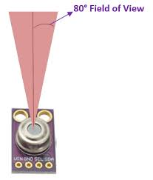
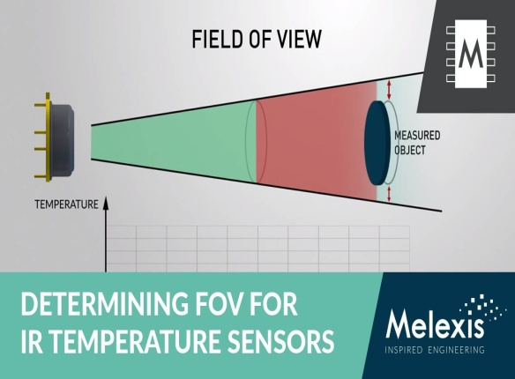
What should be the distance between the sensor and the object?
Field of view (FOV) 80 degree angle
Sensing area in cone shape
sensing area is very narrow if it's near the object
gets increasingly wider as it moves farther away
NOTE:
Every 1cm you move away from an object, the sensing area grows by 2cm. If you're one foot away from an object (30.48cm), the sensing area will be two feet (60.96cm).

Slide 17
ADVANTAGES ………
SANITIZER DISPENSER
Because of their modern appearance, they attract attention which can increase hand hygiene compliance.
They are very easy to install.
They are easy to use, particularly for people that struggle to reach over countertops to access the dispenser.
They deliver a standardized dose of hand soap or sanitizer.
They eliminate a common contact point where germs can be transferred.

Slide 18
ADVANTAGES……….
Contactless thermometer
The non-contact infrared thermometer is a reliable, comfortable and accurate option for measurement of temperature and is very useful for the screening of fever in the paediatric population.
Small in size and low cost
Easy to integrate
Automative grade
Customizable PWM output for continuous reading

Slide 19

CONCLUSION…..
our project setup can be made in each and every houses and can be used each time when housemates go out to buy essential items and when they come in .
Even this setup can be made in all the public places where the people can be able to get sanitized and monitored with their temperature without any contact.This would ensure sound health for all.
Through this research work, we learned real world applications of microcontrollers and embedded systems. In future, mobile application will be developed on the Android platform with more intuitive in the field of health care

Slide 20
THANK YOU…..
ANY QUERYS !!!!

